Slide 1





AUTOGENICS: Automated Generation of Context-Aware Inline Comments for Code Snippets on Programming Q&A Sites Using LLM Suborno Deb Bappon, Saikat Mondal, Banani Roy Department of Computer Science, University of Saskatchewan
24th IEEE International Conference on Source Code Analysis & Manipulation (SCAM 2024)
Flagstaff, Arizona, USA
Software Analytics Research (SOAR)

Slide 2
Outlines
Introduction
Motivations & Research Gap
Related Work
Goal & Research Questions
Contributions
Research Methodology
Results
Conclusion
Software Analytics Research (SOAR)
1

Slide 3
Introduction
• Source code comments are crucial for enhancing code comprehension.
• Code snippets in programming Q&A sites like Stack Overflow often lack of comments.
• Several factors contribute to the absence of comments:
✓ Stack Overflow participation is voluntary.
✓ Developers face time constraints.
✓ Manually adding comments is tedious.
• Snippets on Stack Overflow are typically brief statements, not full methods.
• Inline comments fit better in this context.
• There is growing research on automated comment generation tools.
Software Analytics Research (SOAR)
2

Slide 4
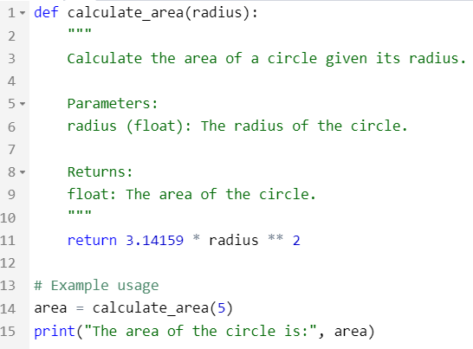
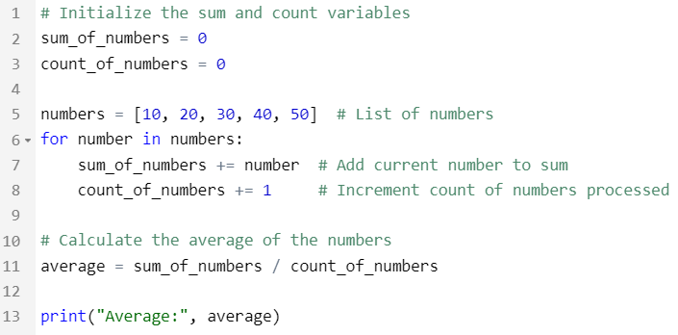
What is Inline Comment?
An inline comment is a single-line comment typically used to explain or clarify a specific line of code.
Python: Starts with #.
Extends to the immediate before or end of the line on which it appears.
Used to provide brief explanations, notes, or reminders directly related to the code on a specific line.
Java: Starts with two forward slashes //.
Fig. 1: Example of method-level comments in code.
Fig. 2: Example of inline comments in code.​
https://pep8.org/#inline-comments
https://docs.oracle.com/javase/specs/jls/se19/html/jls-3.html
Software Analytics Research (SOAR)
3

Slide 5
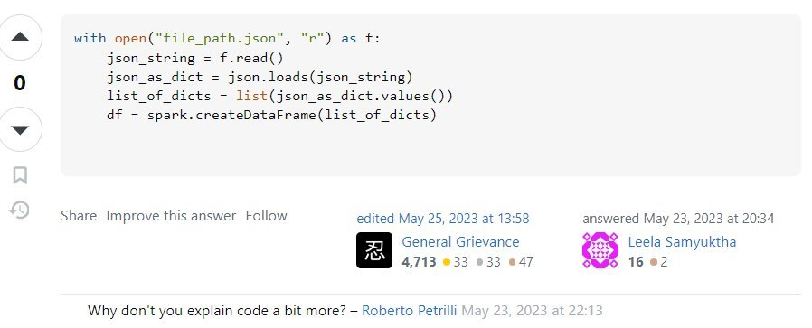
Motivations & Research Gap
More than 582K answer code snippets have neither inline comments nor explanations.
Stack overflow code examples often lack usability, leading to misuse.
Developers find undocumented code frustrating.
Undocumented code may negatively impact on a Stack Overflow post’s score.
Prior studies mostly focus on method-level comment generation.
Necessity for automated inline commenting tool on Stack Overflow.
Fig. 3: Example of a Python code snippet without having inline comments on Stack Overflow.
Software Analytics Research (SOAR)
4

Slide 6
Related Work
Template-based Approach:
Sridhara et al. developed an automatic technique to identify code fragments representing high-level actions and generate concise natural language descriptions, improving program comprehension and aiding software maintenance efforts​. [1]
Information Retrieval(IR)-based Approach:
Wong et al. introduced AutoComment, a system that mines code-description mappings from Q&A sites like Stack Overflow to automatically generate accurate and useful comments for similar code segments in open-source projects​. [2]
Software Analytics Research (SOAR)
5

Slide 7
Related Work (Cont.)
Deep-Learning Approaches:
Iyer et al. introduced RNN networks with attention mechanisms to create summaries for C# code snippets and SQL queries. [3]
Hu et al. developed DeepCom to enhance comment quality by integrating both semantic and structural information. [4]
LeClair et al. introduce the ast-attendgru model, which incorporates a standard encoder-decoder framework enhanced by an additional encoder for a flattened Abstract Syntax Tree (AST) using the SBT technique. [5]
Software Analytics Research (SOAR)
6

Slide 8
Goal & Research Questions
RQ1: How effective are LLMs at generating inline comments for code snippets found in Stack Overflow answers?
RQ2: How do developers perceive the comprehensibility of code snippets with the presence of inline comments?
RQ3: Can we introduce a tool into Stack Overflow to generate context-aware, noise-free, inline comments for code snippets? Are these comments more effective than those from standard LLMs?
Bridging the existing research gap by developing AUTOGENICS, a browser plugin that can be effectively integrated to Stack Overflow to generate effective, context-aware, and noise-free inline comments.
Software Analytics Research (SOAR)
7

Slide 9
Contributions
Manual evaluation of the effectiveness of LLM-generated inline comments
A survey of developers' perceptions
Development of AUTOGENICS browser-plugin
Software Analytics Research (SOAR)
8

Slide 10
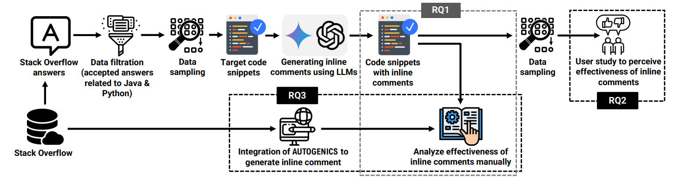
Research Methodology
Dataset Preparation
Inline Comment Generation
Inline Comments' Effectiveness Evaluation
Developer Survey
Development of AUTOGENICS
Fig. 4: Overview of our proposed methodology.
Software Analytics Research (SOAR)
9

Slide 11
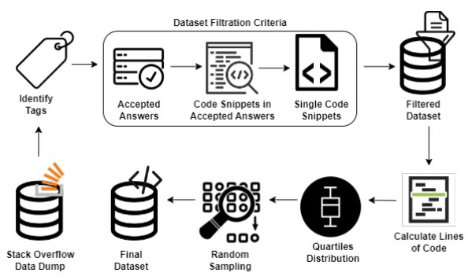
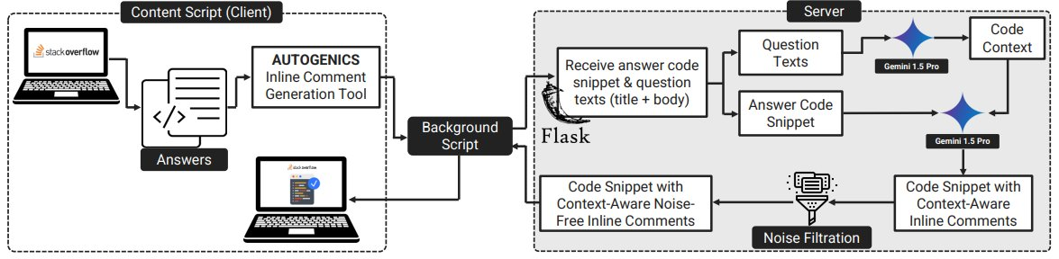
Research Methodology (Contd.)
1
Accuracy
Adequacy
Conciseness
Usefulness
Dataset Preparation
3
Effectiveness Evaluation
Metrics
4
Developer Survey
Fig. 5: Dataset preparation steps.
2
Inline Comment Generation
5
AUTOGENICS Architecture
Applied Gemini-1.5 Pro
Conducted case study using GPT-4
Fig. 6: AUTOGENICS system architecture.
Software Analytics Research (SOAR)
10

Slide 12
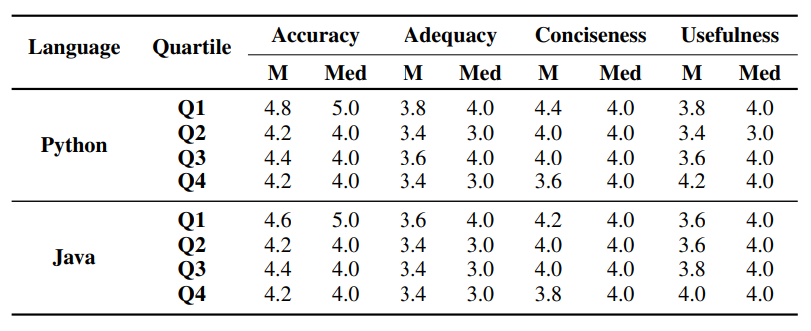
Results – RQ1
Table 1: Evaluation of Gemini-generated inline comments for Python and Java.
Table 2: Evaluation of case study with GPT-4 in generating inline comments for Python and Java.
Language | Quartile | Accuracy |  | Adequacy |  | Conciseness |  | Usefulness
Python |  | Mean | Median | Mean | Median | Mean | Median | Mean | Median
 | Q1 | 4.65 | 5 | 4.12 | 4 | 4.36 | 4 | 3.94 | 4
 | Q2 | 4.70 | 5 | 4.16 | 4 | 4.26 | 4 | 4.40 | 4
 | Q3 | 4.88 | 5 | 4.24 | 4 | 4.14 | 4 | 4.60 | 5
 | Q4 | 4.74 | 5 | 4.34 | 4 | 3.92 | 4 | 4.76 | 5
Java | Q1 | 4.80 | 5 | 4.14 | 4 | 4.40 | 4 | 3.86 | 4
 | Q2 | 4.82 | 5 | 4.26 | 4 | 4.32 | 4 | 4.36 | 4
 | Q3 | 4.86 | 5 | 4.32 | 4 | 4.24 | 4 | 4.56 | 5
 | Q4 | 4.70 | 5 | 4.38 | 4 | 3.96 | 4 | 4.72 | 5
Software Analytics Research (SOAR)​
11

Slide 13
Results – RQ1(Contd.)
Gemini 1.5 Pro model generates highly accurate and adequate inline comments, especially for moderately longer code snippets.
GPT-4 excels with comparatively shorter snippets.
Gemini 1.5 Pro is cost effective and performs comparably with GPT-4.
Problem: Comments are generic and sometimes noisy.
Software Analytics Research (SOAR)​
12

Slide 14
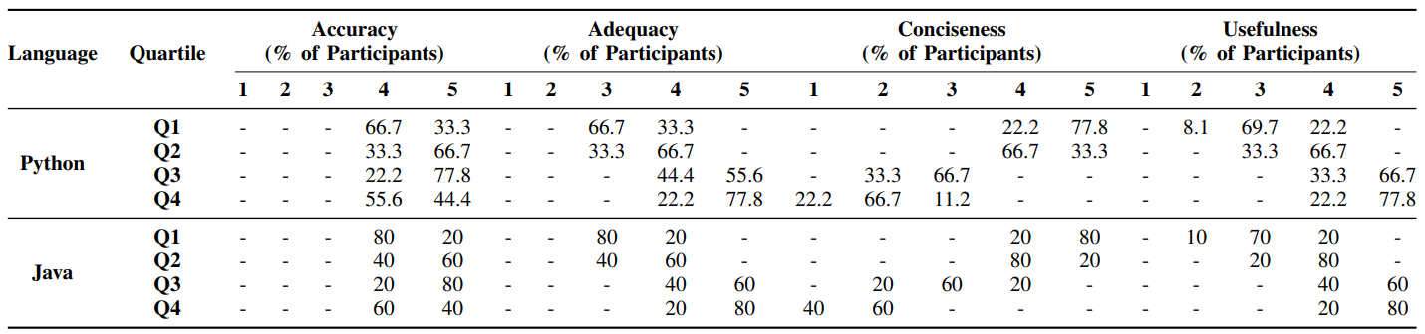
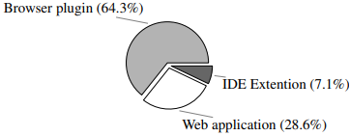
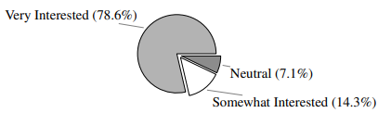
Results – RQ2
Table 3: Summary of survey participants' evaluations.
Most participants found LLM-generated inline comments effective.
Demand for automated inline commenting tools (especially browser-plugin).
Fig. 7: Interest levels and preferences for automated tools.
Software Analytics Research (SOAR)​
13

Slide 15
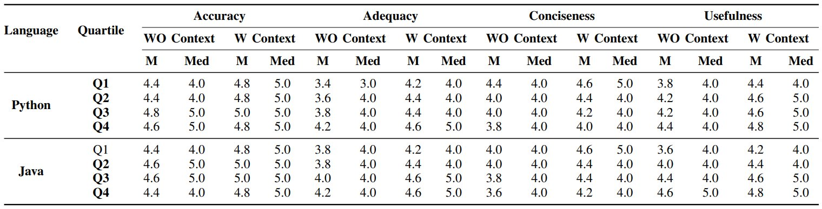
Results – RQ3
Table 4: Evaluation summary of conventional and context-aware noise-free inline comments.
Comment quality enhanced significantly.
Software Analytics Research (SOAR)​
14

Slide 16
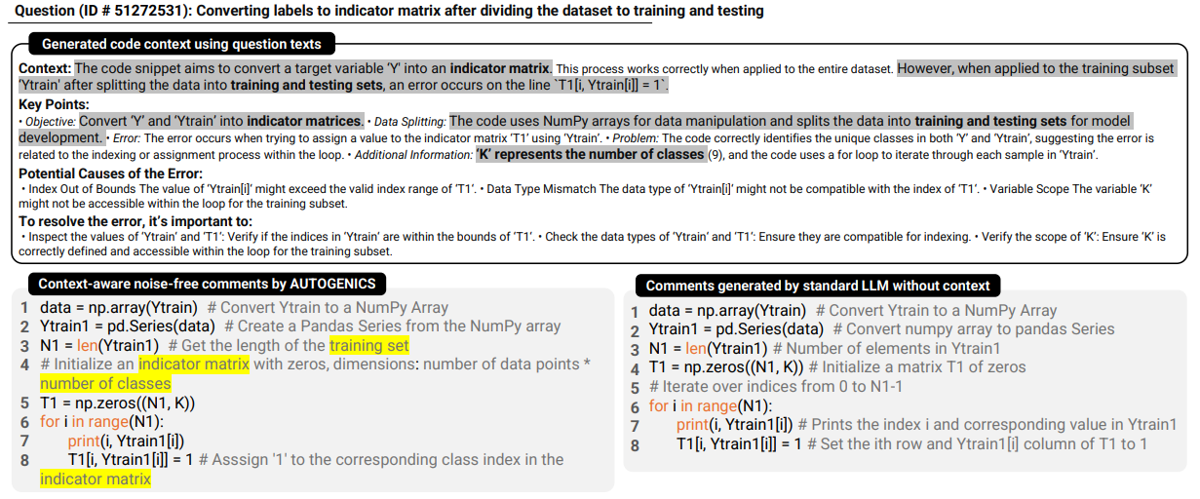
Results – RQ3
Fig. 8: AUTOGENICS working example.
Software Analytics Research (SOAR)​
15

Slide 17
Conclusion
LLMs improve in accuracy, and usefulness with increased code length but struggle with conciseness.
The survey supports that LLMs improve code comprehension, particularly for moderately larger snippets.
The survey shows the demand for automated tools.
AUTOGENICS can assist developers in code comprehension tasks.
Expand research to more languages and gather user feedback.
Software Analytics Research (SOAR)
16

Slide 18
References
[1] G. Sridhara, L. Pollock, and K. Vijay-Shanker, “Automatically detecting and describing high level actions within methods,” in Proceedings of the 33rd International Conference on Software Engineering, 2011, pp. 101– 110.
[2] E. Wong, J. Yang, and L. Tan, “Autocomment: Mining question and answer sites for automatic comment generation,” in 2013 28th IEEE/ACM International Conference on Automated Software Engineering (ASE). IEEE, 2013, pp. 562–567.
[3] S. Iyer, I. Konstas, A. Cheung, and L. Zettlemoyer, “Summarizing source code using a neural attention model,” in 54th Annual Meeting of the Association for Computational Linguistics 2016. Association for Computational Linguistics, 2016, pp. 2073–2083.
[4] X. Hu, G. Li, X. Xia, D. Lo, and Z. Jin, “Deep code comment generation,” in Proceedings of the 26th conference on program comprehension, 2018, pp. 200–210.
[5] Alexander LeClair, Siyuan Jiang, and Collin McMillan. 2019. A neural model for generating natural language summaries of program subroutines. In Proceedings of the 41st International Conference on Software Engineering. IEEE Press, 795–806.
Software Analytics Research (SOAR)
17

Slide 19
Thank You!

